Slide 1
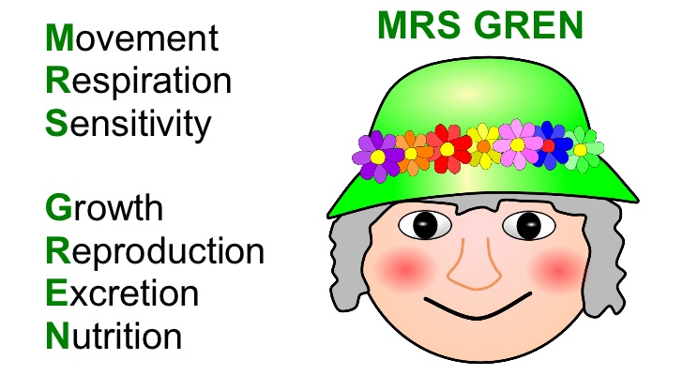
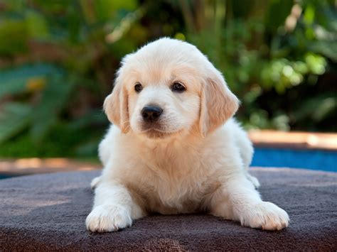
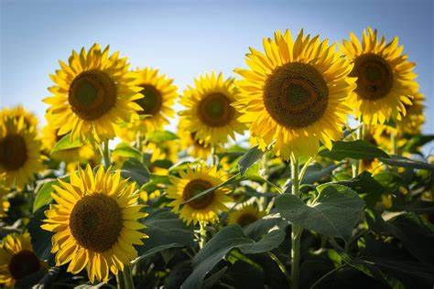
Living Things – Page 1
In the following passage, underline or highlight all the key-words and information. Then, answer the questions on the back
Living things are all around us, and they come in many different shapes and sizes. From tiny ants to giant elephants, living things make up the vast diversity of life on our planet. But what makes something alive? To figure this out, we can use the acronym MRS GREN. For a thing to be alive, it must be able to:
Move
Respire (or breath)
Sense things
Grow
Reproduce (or have kids)
Excrete (or go to the toilet)
Nutrition (need food/drink)
Dogs are living things because they have all the things that make living things special. They can move around and play, breathe air to stay alive, and feel things and respond to them. Dogs grow bigger as they get older and can have puppies. They also need to go to the bathroom, eat food, and drink water. All these things together mean that dogs are living things!
Sunflowers are also alive just like us and dogs! They move their heads to follow the sun, breathe in carbon dioxide, and can feel changes in their environment. Sunflowers grow from tiny seeds to tall plants, and they can make new seeds. They also take in nutrients from the soil and release waste products like oxygen. All these things together mean that sunflowers are living things!

Slide 2
Living Things – Page 2
What can we use to figure out if something is living?
______________________________________________________________________
What does MRS GREN stand for?
M_____________________
R_____________________
S_____________________
G_____________________
R_____________________
E_____________________
N_____________________
Are dogs living things or non-living things?
______________________________________________________________________
What are three reasons we can use to prove that dogs are living?
__________________________________________________________________
__________________________________________________________________
__________________________________________________________________
Are sunflowers living things or non-living things?
______________________________________________________________________
What are three reasons we can use to prove that sunflowers are living?
__________________________________________________________________
__________________________________________________________________
__________________________________________________________________

